Slide 1

Cisco Secure Access
Tectorial – From Zero to Hero
Bruno Fagioli
CCIE Security
21-Feb-24
Notes:
5min

Slide 2

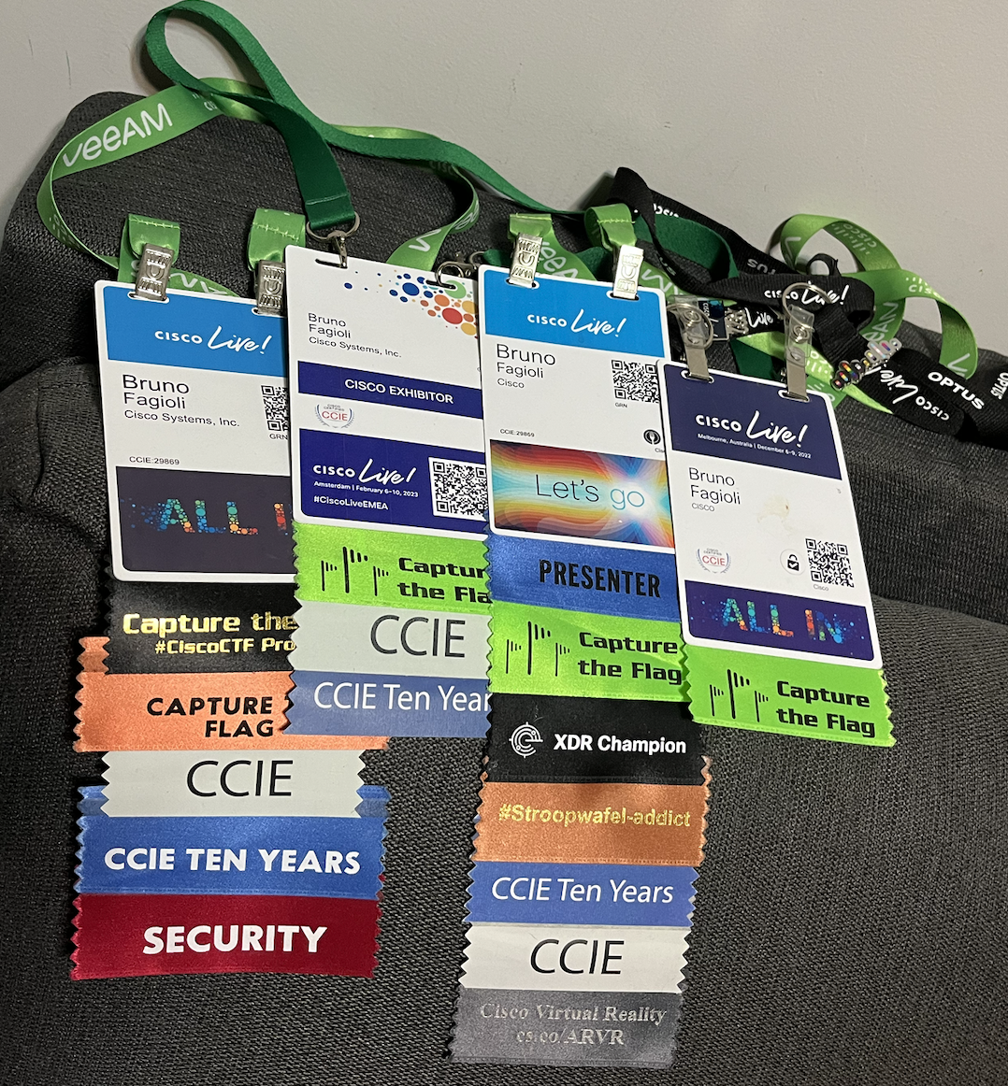

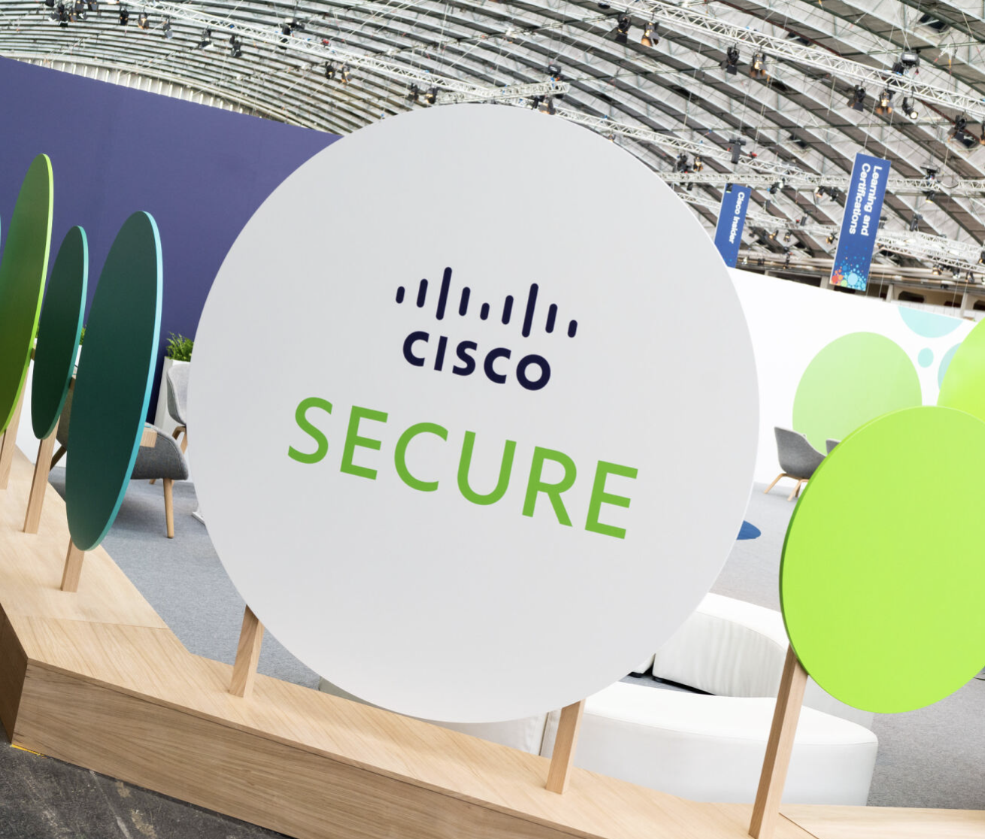
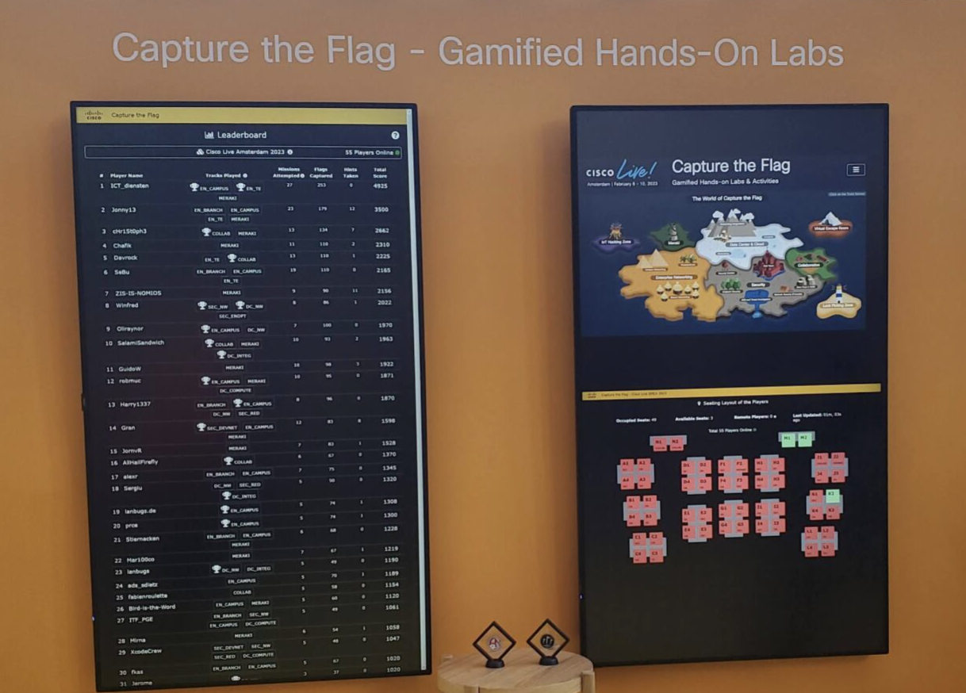
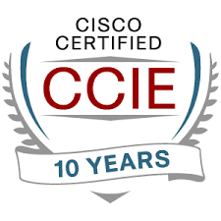

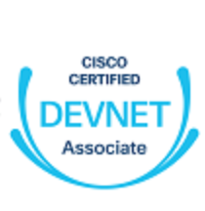


whoami
Cisco Partner Security TSA
20 anos na indústria de redes/cibersegurança
4 anos na Cisco
Líder SME em Access e Endpoint
Lider de segurança no Cisco CTF

Slide 3

What is Secure Access?
Tectorial topology
Connect
Resources
Secure
Tests
Monitor

Slide 4
What is SSE?
Notes:
5min

Slide 5

Employees are frustrated
64%
believe the way they interact with technology directly impacts morale
65%
believe they would be more productive if they had better technology
Ivanti Study

Slide 6






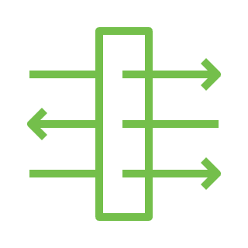


Market is moving to Security Service Edge
SSE is a cloud-based security service that provides safe access to Internet and private applications.
65%
plan on adopting SSE in next 2 years
SASE
Secure SD-WAN Fabric
Performance-based Internet Routing
On-prem Unified Threat Management
On-ramp into Public IaaS and Private Cloud
SD-WAN Analytics (including Internet Intelligence)
Cloud Access Security Broker (CASB)
Firewall as a Service (FWaaS)
Zero Trust Network Access (ZTNA)
Secure Web Gateway (SWG)
SD-WAN
SSE

Slide 7
Cisco Secure Access Architecture
Notes:
15min

Slide 8





Architecture Overview
Cisco Secure Access
Internet Traffic
Private Traffic
Secure Tunnel
Breakout (unmonitored internet and trusted SaaS)
Public Applications
Secure Access
Managed Endpoint
Private Applications
Unified Dashboard
Identity and Continuous Posture-based Controls
Single SLA
Single Policy
Magnetic Design System
Unified Security
Single data path
Consistent inspection for all traffic
Flexible ingress/egress connectivity
Internet/SaaS
Clientless Access
Unmanaged
ZTNA Private Applications via App Connector or Backhaul VPN
Public/Private Cloud
Public Applications
POPs in Public Cloud and Cisco Edge Data Centers
On Premise,
Users, Devices & Things
Private Applications
SD-WAN
DC/Colo/ Branch
Who
How
What

Slide 9


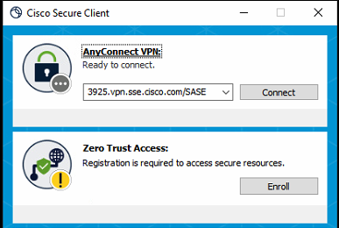
ZTNA Architecture
Module Socket Interception
Socket Filter Advantages
→ Control of over DNS and application traffic before VPN
→ No route table manipulation
→ Capture Traffic based on FQDN, Wildcard, IP, or IP subnet
→ Interoperate with existing Cisco & Non-Cisco VPN solutions
Application
Socket Intercept / Filter
ZTNA
Packet Intercept / Filter
Routing Table
Packet Intercept / Filter
VPN
Virtual Interface
Physical Interface

Slide 10



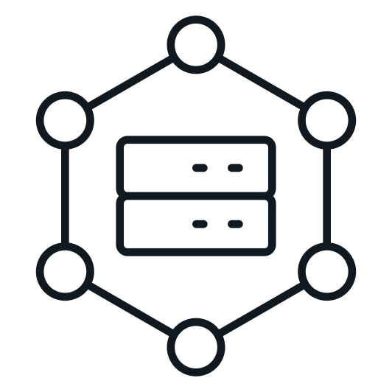
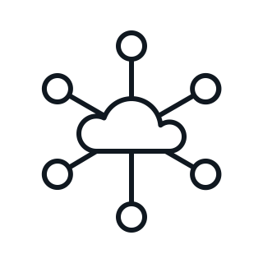


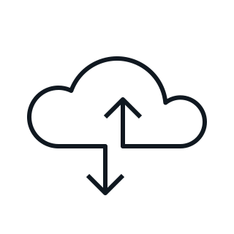
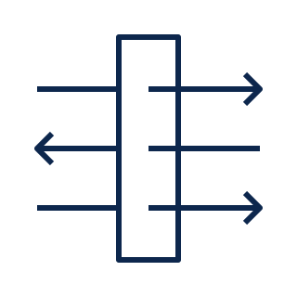

Tectorial architecture
Internet Traffic
Private Traffic
Secure Tunnel
Traffic Acquisition
Secure Access
VPN Pool:
172.31.33.0/24
VPN or Umbrella Module
Public Applications
Block: Tinder
Warn: Facebook
Allow: the rest
Managed Endpoint
Private Access
Internet Access
Remote VPN
Device Posture & Health
SWG
DLP
CASB
Internet Access
Internet/SaaS
Services
Router
CGNAT
ZTNA Module
Auth
NAT
Managed Endpoint
Private Access
ZTNA
ZTNA
Proxy
Firepower 7.4
Private Applications via Backhaul VPN
IP: 10.1.1.0/24
SSH, HTTPS, ICMP
Services
Router
L3/4/7 FW IPS
HTTPS
Browser
Private Apps
ZTNA
Clientless
Browser-based ZTNA
DC/Colo/ Branch
Who
How
What

Slide 11
Gitlab – documentation http://cs.co/9005nw2O5
Notes:
15min

